Slide 1
Analysis of team performances at the ICC World Twenty20 Cup 2014
Faculty Guide: submitted by:
Dr.mrityunjay pal singh gagan sharma
A4479219034
AIAS

Slide 2


Slide 3
Abstract
Cricket has evolved in recent years and has resulted in the emergence of Twenty20 cricket. I examined the batting, bowling and fielding variables associated with success in cricket in the recent Twenty20 World Cup. I compared several key batting and bowling variables of winning and non-winning teams by comparing the magnitudes of differences (Cohen’s effect size). I established several moderate or large differences between winning and losing teams with respect to batting, bowling and fielding variables. The best indicators of success in the tournament can be broken down into general match, batting and fielding variables. The top 5 indicators for success in the tournament were losing less wickets in the game (ES= -1.66), losing less wickets in the powerplay while batting (ES= -1.22), scoring more runs per over (ES= 1.23), scoring more runs in the middle eight overs (ES= 0.86) and bowling more dot balls (ES= 1.15). Thus it could be concluded that for overall success in Twenty20 cricket, teams should focus on taking wickets and bowling dot balls whilst fielding, and implementing tactics that encourage 50+ partnerships and boundary hitting batsmen whilst batting.

Slide 4
Introduction
After football, cricket is most loved and watched by many individuals in the world but in India cricket is the most loved sport. In the past few years, lots of research papers are published and lots of work is done which predicts the result of a cricket match by using the factors that affect the match outcome and they are using the supervised machine learning algorithms to predict the outcome of the match like Linear regression, support vector machines, logistic regression, decision tree, Bayes network, random forest. Cricket is one of the most well-liked sports in the world. Especially the Twenty20 format is very popular as it is a fast-paced form of the game that attracts the spectators at the ground and the viewers at home.
Cricket, a game popular in the majority of the British Commonwealth Countries as well as some other countries, is played in a standard format called a test match for a long period. The test match is a two innings per team contest that is played over five days. The monotony of the game owing to the long duration and inconclusiveness of end result referred to as a draw in cricketing jargon, newer formats evolved. The newer format shortened the duration to one where each team plays one innings with limited number of overs. This format was commercially successful and spectators enjoyed shorter version of the cricket.

Slide 5
To those who are not familiar with the game of cricket, Preston and Thomas (2000) summarize the important concepts of limited overs cricket. The latest version of the limited over cricket is more shorter where each team is allowed to bat and bowl for maximum 20 overs. This format of cricket is a popular evening entertainment and the duration of the game or match is around two and half hours which is close to other sports such as football, basketball etc. Twenty20 was introduced to create a lively form of cricket which would be attractive to spectators at the ground and viewers on television. The commercial success of this format introduced World Tournament and Indian Premier League (IPL).
The cricket team is a group 11 players consisting of batsmen, bowler and all rounders.
The team should be balanced and diversified to enhance the probability of the success. In addition, the success can also depend on the type of pitch, winning of toss, and sequence of batting or bowling.
In general, cricket enthusiasts and experts are of the opinion that batting dominates over bowling. Although, this opinion is widely expressed by many in the cricketing sport, research evidence in a formal study is not available.

Slide 6
Data
Real world data is dirty. We can’t expect a nicely formatted and clean data. Therefore, data pre-processing is so crucial that I can’t stress enough how important it is. It is the most important stage as it could occupy 40%-70% of the whole workflow, just to clean the data to be fed to your models. I scraped scripts from espncricinfo website
(https://stats.espncricinfo.com/ci/engine/records/team/match_results.html?id=8083;type=tournament)
comprising of rankings of teams as of March 2014, details of the fixtures of 2014 world cup and details of each team’s history in previous world cups. I stored the above piece of data in csv file.
For future research: Then I did manual cleaning of the data as per my needs to make a machine learning model out of it.

Slide 7
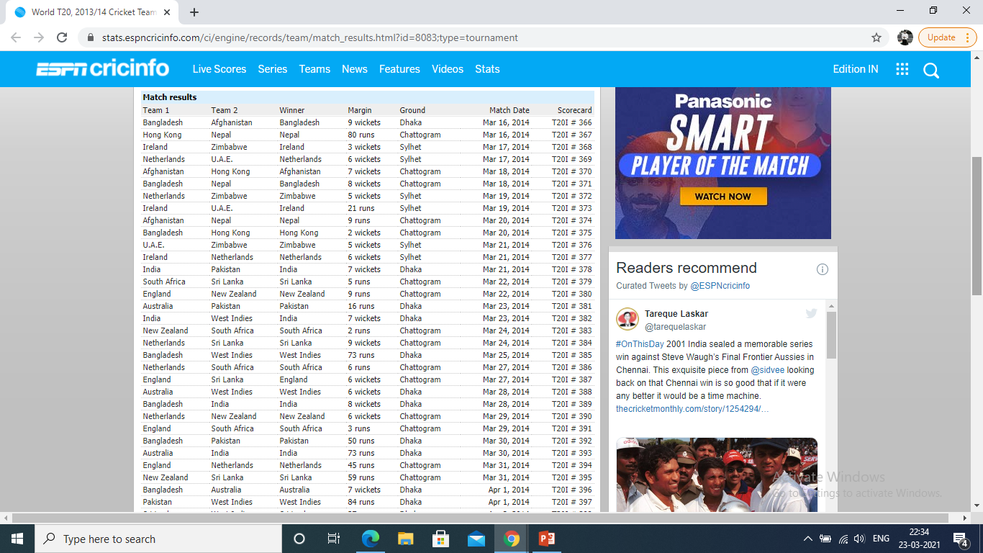

Slide 8
Methodology
This retrospective study analysed data from all matches played in the ICC World Twenty20 Cup. The match data were obtained from ball by ball commentary and match score cards. The tournament consisted of twelve teams (nine Test match playing nations and 3 qualifiers from associate countries). The tournament is comprised of three stages namely the group, Super 8 and knockout stage the latter including the semi-finals and final. Teams are separated into the four groups based on their finishing position in the tournament. The top two teams from each of the groups progress to the Super 8 stages. In the Super 8 stage the teams are divided into two groups and each team play against one another once and the two teams that end up at the top of the table of each group progress to the knockout stage. All the games were played on three grounds around Dhaka, Chittagong and Sylhet. This means that all the games were played on neutral venues for all the teams except the hosting team Srilanka, who played all their games at a “home” venue. The selection of the variables for comparison were selected on the basis of the study by Petersen et al (2008a), as well as other applicable variables from the cricketing literature that would have an effect on winning and losing the game1.

Slide 9
Methodology : Statistical Analysis
Data are displayed as mean ± standard deviations (SD) unless otherwise stated. The Students t-tests were used to calculate significant differences between the winning and non-winning 49 teams. The Cohen‟s d-test was used to determine the magnitude of the effect size between the two groups (Batterham and Hopkins, 2006; Cohen, 1988; Cohen, 1992). The positive values indicate that the performance variable contributed towards the success of the winning team, while negative values indicate that the non-winning team was more successful in that particular variable. The d-value calculated indicates the effect size or magnitude of difference. This method of statistical analysis was used based on previous work on the topic.

Slide 10

Results
At the conclusion of the tournament 27 matches had been played
12 during the group stage, 12 during the Super 8 stage, 2 semi-final matches and 1 final match.
Three of the matches were affected by bad weather and thus the result was decided by the Duckworth-Lewis System (Duckworth et al., 2002); these 3 matches were excluded from further analysis.

Slide 11
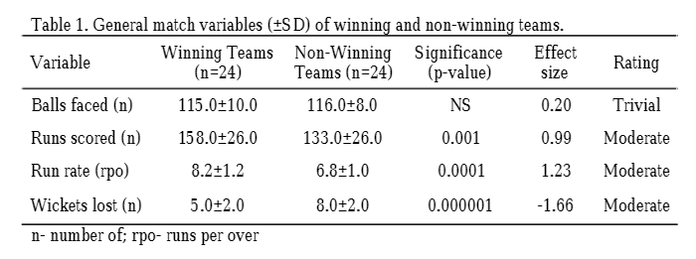
General match variables were calculated by dividing the groups by 24 because out of the 24 matches analyzed there was a winning (n=24) and non-winning (n=24) result (Table 1).
Although it might seem obvious that Winning teams score more runs than losing teams, on average the Winning team scored 25 more runs than the non-winning teams (ES=0.99) at a rate of 1.4 runs per over higher (ES=1.23) and lost an average of 3 less wickets per game than non-winning team (ES= -1.66).

Slide 12


Slide 13
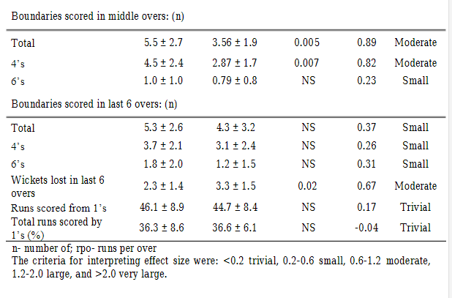
The biggest difference in batting performance between winning and non-winning teams is the wickets lost whilst batting during the “powerplay” (ES=-1.22),
Total number of boundaries (particularly 4‟s) scored during the middle overs (ES=0.89 and ES=0.82 respectively)
Number of 50 run partnerships (ES=1.23).

Slide 14
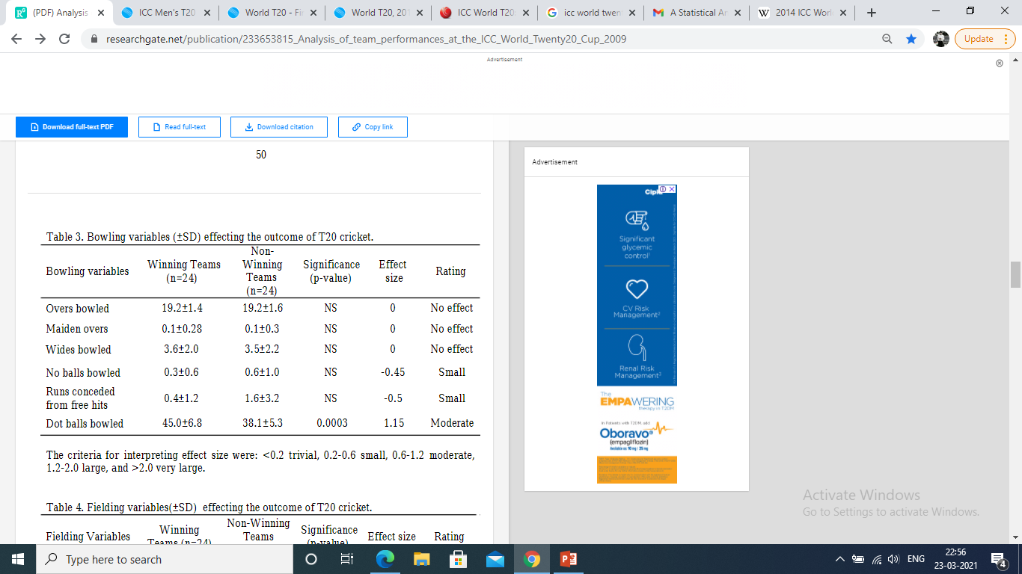
A significant difference found with bowling variables were dot balls bowled (ES=1.15).
Winning teams bowled significantly more dot balls than non-winning teams throughout the innings
There were no differences between the groups for maidens or wide deliveries bowled.(Table 3)

Slide 15
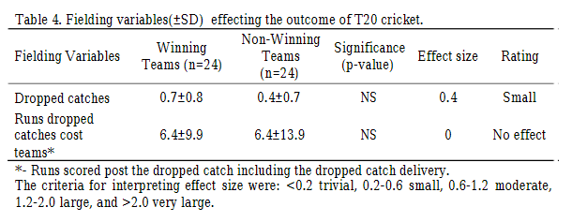
Interestingly winning teams dropped more catches than non-winning teams, however this only has a small effect on the outcome of the game (ES=0.4)
This is probably because the number of runs conceded from drop-catches was not significant (Table 4).

Slide 16
Discussion
Winning the toss is regarded by many as an important determinant in the outcome of the match, however 54% of the teams that lost the toss went on to win the game in the tournament. Thus losing the toss was not a disadvantage, certainly in the context of the data analysed in this study. This was supported by an analysis of 427 ODI‟s by De Silva and Schwartz(1997) who revealed that winning the toss provided no competitive advantage. Other studies examined the outcome of one-day or five-day international matches (Peterson et al., 2008a and 2008b), confirmed the views of De Silva et al that winning the toss had no effect on the outcome of the game (De Silva and Swartz, 1992). Of the captains who won the toss 54% choose to bat first and of these 62% of teams went on to win the game.
Interestingly Petersen et al. (2008a), found that captains who won the toss favoured to field first, and 61% of these teams went on to win the game. Their reasons were based on the dew factor (precipitation), as bowling becomes more difficult in the evenings 52 with wet balls (Peterson et al., 2008a). This however was purely speculative because they did not measure or factor for environmental conditions during each match.

Slide 17
The probable reasons for why captains in this tournament choose to bat first was too put pressure on the other team by having the “runs on the board”, or possibly that they felt the conditions were better for batting first as the wicket would slow-up and become more difficult to bat on at a later stage, bearing in mind that the pitches were used for more than one game.
Magnitudes of differences (effect size) were calculated for selected performance variables:
General match variables (Table 1);
Batting variables (Table 2);
Bowling variables (Table 3);
Fielding variables (Table 4)
between winning and non-winning teams. When considering batting variables winning teams had a tendency to lose less wickets in the first 6 overs (powerplay), and the last 6 overs of the innings thus losing less wickets overall in the games, conservation of wickets throughout the game is an important factor determining the outcome of the game. Winning teams also exhibited stronger partnerships, with significantly more >50 run partnerships than the non-winning teams.

Slide 18
In the first 6 overs (power play) winning teams scored more runs in total.
Faced less dot balls in the power play.
More runs from boundaries (4‟s and 6‟s).
Hitting more 4‟s contributes more to success (greater ES) than hitting 6‟s, thus more emphasis should be placed on hitting boundary fours throughout the innings without risking taking on the fielders to clear the boundaries (for 6‟s). Team strategies should therefore focus on selection of players who can strike boundaries upfront without taking significant risks and losing their wickets. Also players should be selected considering amongst other factors their strike rates and ability to rotate the strike upfront.
With respect to the bowling variables winning and non-winning teams differed in the amount of dot balls bowled throughout the innings.
No differences between the teams with respect to overs bowled, maiden overs bowled as well as wide deliveries bowled
Our results indicate that bowling strategies should focus on bowling dot balls throughout the innings as well as taking wickets, especially in the first and last 6 overs of the innings.

Slide 19
Conclusion
The variables that determine success during the ICC Twenty20 World Cup 2014 were restriction of run rates of the batting team by taking more wickets throughout the innings especially in the first 6 overs of the game, as well as bowling more dot balls throughout the innings.
These data suggest that team selection should focus on wicket taking bowlers who can take wickets at the beginning of the innings as well as bowlers who can restrict boundaries in the middle and last 6 overs.
Batting strategies should focus on scoring boundaries in the “powerplay” by playing risk free cricket.
Emphasis should also be placed on rotation of the strike and high strike rates of all batters (less dot balls)

Slide 20
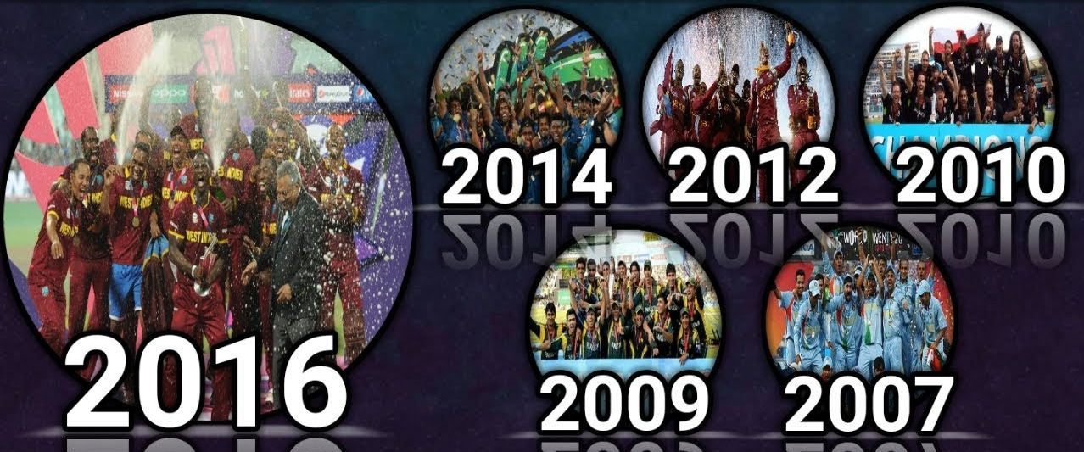
Thank you

